Slide 1
MK MANAJEMEN PEMASARAN: STUDY TO DEVELOP TO INTEGRATION THE MARKETING MODEL AND MULTIVARIATE DATA ANALYSIS CONDUCT TO SEM SMARTPLS 3.2.9- 2022-23
Dr. WILHELMUS HARY SUSILO

Slide 2
MK MARKETING
MAGISTER –MM FEB UPI YAI-JAKARTA-2022-23

Slide 3
Model PENELITIAN PEMASRAN BERBASIS TEORI & INTEGRASI HASIL PUBLIKASI PADA JURNAL INTERNASIONAL

Slide 4
PILOT MARKETING MODEL BERBASIS SMARTPLS V 3.2.9

Slide 5
INDUSTRY DAN DUNIA KERJA
STAKEHOLDER
KAMPUS
INDUSTRY
DUNIA KERJA
SOS-BUD
VALUE CREATION
NEWEST TECHNOLOGY

Slide 6
OUTCOME
SDM PROFESIONAL
KEBUTUHAN INDUSTRY DAN DUNIA KERJA
SOFTSKILL DAN KEPEMIMPINAN

Slide 7
PROJECT BASE LEARNING
PROBLEM BASE LEARNING
PROBLEM SOLVING
ANALISIS PROBLEM RIIL- CONDUCT TO THE QUASY-EXPERIMENTAL RESEARCH
KEMAMPUAN TEKNIS- WAWASAN DAN PENGEMBANGAN TEORY DAN ILMU PENGETAHUAN TERKINI & TECHNOLOGY
INNOVATION, DAYA SAING, GLOBAL

Slide 8
INTRODUCTION
TYPE OF BUSINESS RESEARCH- UNDERTAKEN FOR TWO DIFFERENT PURPOSE (Sekaran and Bougie): (Magister Terapan)
APPLIED RESEARCH
SOLVE THE CURRENT PROBLEM FACED BY MANAGER IN WORK SETTING
DEMANDING A TIMELY SOLUTION
BASIC, FUNDAMENTAL OR PURE RESEARCH
TO COMPREHEND/ memahami
TO TAKE CORRECTIVE ACTION
TO GENERATE A BODY OF KNOWLEDGE AMONG THEORITICAL.
HOW CERTAIN/tertentu PROBLEMS THAT OCCUR/terjadi IN ORGANIZATION CAN BE SOLVED

Slide 9
Contoh: SOLVE THE CURRENT PROBLEM FACED BY MANAGER IN WORK SETTING
Role of motivations for luxury cruise traveling, satisfaction, and involvement in building traveler loyalty

Slide 10
The applied Research Model
Role of motivations for luxury cruise traveling, satisfaction, and involvement in building traveler loyalty Heesup Hana , Sunghyup Sean Hyunb, 2018

Slide 11
SEM- MODEL FULL HYBRID

Slide 12
THE STRUCTURAL MODEL ASSESSNENT

Slide 13
NEXT- THEORY AND MODEL DEVELOPMENT

Slide 14
UNDERSTANDING THE GRAND THEORY IN MARKETING SCIENCE

Slide 15
SDL- THEORY

Slide 16
LITERATURE- THEORITICAL REVIEW

Slide 17
Review methodology Systematic literature review articles
Review methodology Systematic literature review articles come in several forms (Paul & Criado, 2020, Williams et al., 2020) and can be classified as structured reviews (Dhaliwal et al., 2021; Paul & Feliciano-Cestero, 2020; Paul & Singh, 2017; Rebouças & Soares, 2020; (Gilal et al., 2021); Mishra, Singh & Koles, 2020; Åberg et al., 2019), framework-based reviews (Paul, 2020; Paul & Benito, 2018), bibliometric reviews (Donthy et al., 2020; Pattnaik et al., 2020), hybrid reviews (Dabic et al., 2020), reviews aimed at theory development (Paul, 2018), method-based reviews (Ali et al., 2018), meta-analytical reviews (Rana & Paul, 2020), and theory-based reviews (Gilal et al., 2019). We adopt a theory-based approach in this paper to demonstrate the importance of OIT and how it plays an important role in marketing science.

Slide 18
THE RESEARCH MODEL OF PEFORMANCE VS COA

Slide 19
OIT- ORGANISMIC INTEGRATION THEORY

Slide 20
OIT

Slide 21
ARTICLE SCREENING AND ELIGIBILITY CRITERIA

Slide 22
OIT STUDIES ACROSS COUNTRIES

Slide 23
YEAR OF PUBLICATION AND RESEARCH DESIGN METHODS

Slide 24
RESEARCH AREA STUDY

Slide 25
THE STATISTICAL METHODS

Slide 26
SAMPLING METHODS

Slide 27
SAMPLING SIZE

Slide 28
OUTCOME VARIABLES STUDIED IN IOT-VAR INDEPENDENT DAN VAR MEDIATING

Slide 29
THE POTENTIAL RESEARCH TOPICS- INPUT-PROCESS-OUTPUT- VAR DEPENDENT

Slide 30
VARIABEL YANG DAPAT DITERAPKAN DALAM PENELITIAN MANAJEMEN BERBASIS TEORI : OIT
VARIABEL INDEPENDEN | VARIABEL INREVENING | VARIABEL MODERATING | VARIABEL DEPENDEN
 |  | Brand trust | Antusias pada Merek
 |  | Pengetahuan
 |  | Dukungan sosial | Prilaku konsumen yang dapat bekerjasama
 |  | Pengalaman
 |  | Innovasi | Keunggulan Merek
 |  | Identitas
 |  | Orientasi | Niat Membeli
 |  | Keterlibatan pada produk

Slide 31
Alt02- berbasis teory

Slide 32
Proposition 1.
Proposition 1. Intrinsic/integrated, identified, introjected, and external motivations will have a significant positive effect on positive marketing outcomes. Our review of marketing literature suggests that generation cohorts such as generation X, Y, and Z customers (Zuo & Lai, 2020), customers’ gender (Shao et al., 2019), customers’ age (Mora & Vila, 2020), national culture (Nam, 2018), customers’ social comparison orientation (Tariq et al., 2019), brand trust (Khalid et al., 2016), prior knowledge (Johnson et al., 2015), and prior experience (Shao et al.,

Slide 33
RESEARCH FRAME WORK- CRUISE BUSINESS- Evaluating and Categorizing Cruise Lines by ship attributes: A Comparison Between Cruisers and Experts

Slide 34
Shore excursions of cruise destinations: Product categories, resource allocation, and regional differentiation Xiaodong Sun a , Robert Kwortnik b , Meihua Xu a , Yui-yip Lau c,* , Rongxin Ni a, 2021

Slide 35
Global-CSE System

Slide 36
RISET QUALITATIVE- TEMATIK

Slide 37
The SmartPLS 3.2.9- SEM SOFTWARE

Slide 38
THE SMART PLS KONSEP DAN APLIKASI
To analyze the model-management research, a model using the partial least square structural equation modelling (PLS-SEM). The PLS-SEM analysis is suitable to analyze a complex path model, which could not be predicted using a covariant-based SEM. Furthermore, the PLS-SEM is used for a prediction-oriented approach in the human resource management research model. The PLS-SEM is used to identify the configuration for the organization’s innovations to achieve a higher level of organizational performance, leadership etc., of enterprise (Hinterhuber, 2017, Nguyen et al., 2017).
Further, the partial least square in the structural equation modelling have a robust method to anticipate multivariate normality data, the multi-collinearity conditions and blocks within indicators as the observed variables, and determine the errors in the model specification. The partial least square could also utilize samples from small sizes, the reflective and formative construct development, and also the calculate the moderate effect (Cavazotte et al., 2013).

Slide 39
The partial least square (PLS) analysis consists of two stages (Cavazotte et al., 2013, Hair et al., 2011, Ghozali, 2021).
The results from the partial least-square will then be analysed using the bootstrapping technique to assess the level of the significance between the hypothesis using the 2nd order path. The other aim of the bootstrapping technique is to estimate the effect of moderator variable; the such as the Technology/ Industrial Complexity variable within business development among corporate.
The partial least square (PLS) analysis consists of two stages.

Slide 40
The partial least square (PLS) analysis consists of two stages.
I. The Outer Model- First Stage
The calculation would utilize an adequate level of measurement using the loading patterns with its characteristics. The load value must be statistically quite significant. Several conditions needed to be made. First, the cross-loading value as a result for the first order among the latent variables must be lower than the loading parameter. The results are then compared to the extracted average variance (AVE>.50), composite reliability coefficient (CR>.70), and Cronbach’s alpha value (CAV> .70). If the resulted value from the analysis is less than the cut-off value of the parameters, then the indicator will be removed.

Slide 41
Inner Model
Second Stage
The second stage of calculation would evaluate the measurement model within the moderating effect within relation between constructs of among the relevant latent variables
Inner Model
The inner model quality data analysis would enhance the predictive capability of the management science model. The analysis would obtain the R² value of the latent dependent variables such as the organizational performance. Hence, the hypotheses are tested in the significance value evaluation (p-value< 0.05) and the sign would indicate standard estimation of the path coefficient. Using the re-sampling procedures and the bootstrapping technique to assess the statistical output, the inner step analysis. (Cavazotte et al., 2013, Ghozali, 2021).

Slide 42
The Importance Performance Map Analysis (IPMA)
Furthermore, the management research if the model has a moderating variable, an analysis using the product indicator approach (PIA) to assess the moderating effect due to exogenous variable and moderating variable have a reflective form (Ghozali, 2021, Sarstedt et al., 2016). This technique would determine the interaction between multiple indicators for the moderating variable and exogenous variable.
Hence, the Importance Performance Map Analysis (IPMA) would also be used to estimate the path analysis between the given dimensions. The analysis would analyze the average scores of the latent variables and evaluate the important value and the constructs value and, it would give the possibility to make a model refinement.

Slide 43
THE MULTIVARIATE DATA ANALYSIS PROCESS CONDUCT WITH SMART PLS 3.2.9
The business and management model concept.
The first step for among stepping of the data processing analysis to evolve the management and business science have an important moment to determine a best constructs model to pursue the prediction latent variable. The scientist should to develop newest management and busines concept on among construct conduct to refer and study of rooting management theories and reviewed and comparing to the previous research result to build new construct concept. The scheme to review the scholars could uses the Prisma methods, comparation and evaluation table, and conduct to the meta-analysis the construct and result research model that it has hi-relevance constructs.

Slide 44
2. The determine the method of algorithm analyses.
The structural equations modelling has the SmartPLS 3.0 programme conduct to the algorithm- Lohmoller analysis a path/ weighting structural and the scholars determine the sample size between 30- 100 cases or the 10 multiples to the endogenous variable in business research model. (Ghozali, 2021) Moreover, evidence on Hair et al (2010) the sample size determine on range between 100 to 400 respondent.

Slide 45
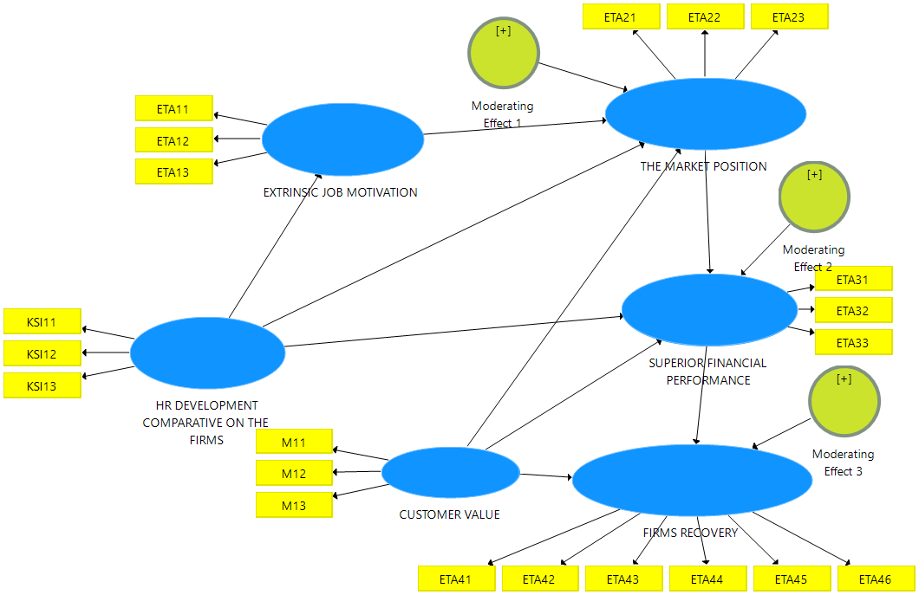
3. Provide the path diagram scheme.
The researcher would be suppose drawing the path diagrams within the nomogram reticular action modeling (RAM) procedure that it could comprises; theoretical construct/ circle, the among observed variables/ squares, the asymmetrical relationship with the single headed arrow.

Slide 46
The management and business model assessments.
The model within SEM PLS that the model conduct to analysis with SmartPLS 3.0 should has to estimation and evaluation comprise the measurement model (outer-model to assessment for validity and reliability latent among construct) and the structural model (inner-model to assessment for the significance of the prediction the relationship- among variable).
The beginning setting data that the scholar must be aware to setting data file settings

Slide 47
OUTER LOADING
The scholars has should to estimation and evaluation comprise the measurement model (outer-model to assessment for validity and reliability latent among construct) that the first model output would provide the figure within the outer-model scheme and the model would be inform pertains; the validity and reliability, r-square value, f square value, q square value and fitting model

Slide 48
OUTER LOADING

Slide 49
The Data of an outer loadings among indicators

Slide 50
The Data of the discriminant validity entire the latent construct- CROSSLOADING

Slide 51
The Data of the construct’s reliability and validity

Slide 52
The Data of assessments for the collinearity statistics’ (VIF) value of entire indicators/ observed variables (for formative only)

Slide 53
The Data for model fit

Slide 54
The Data for the model selection criteria

Slide 55
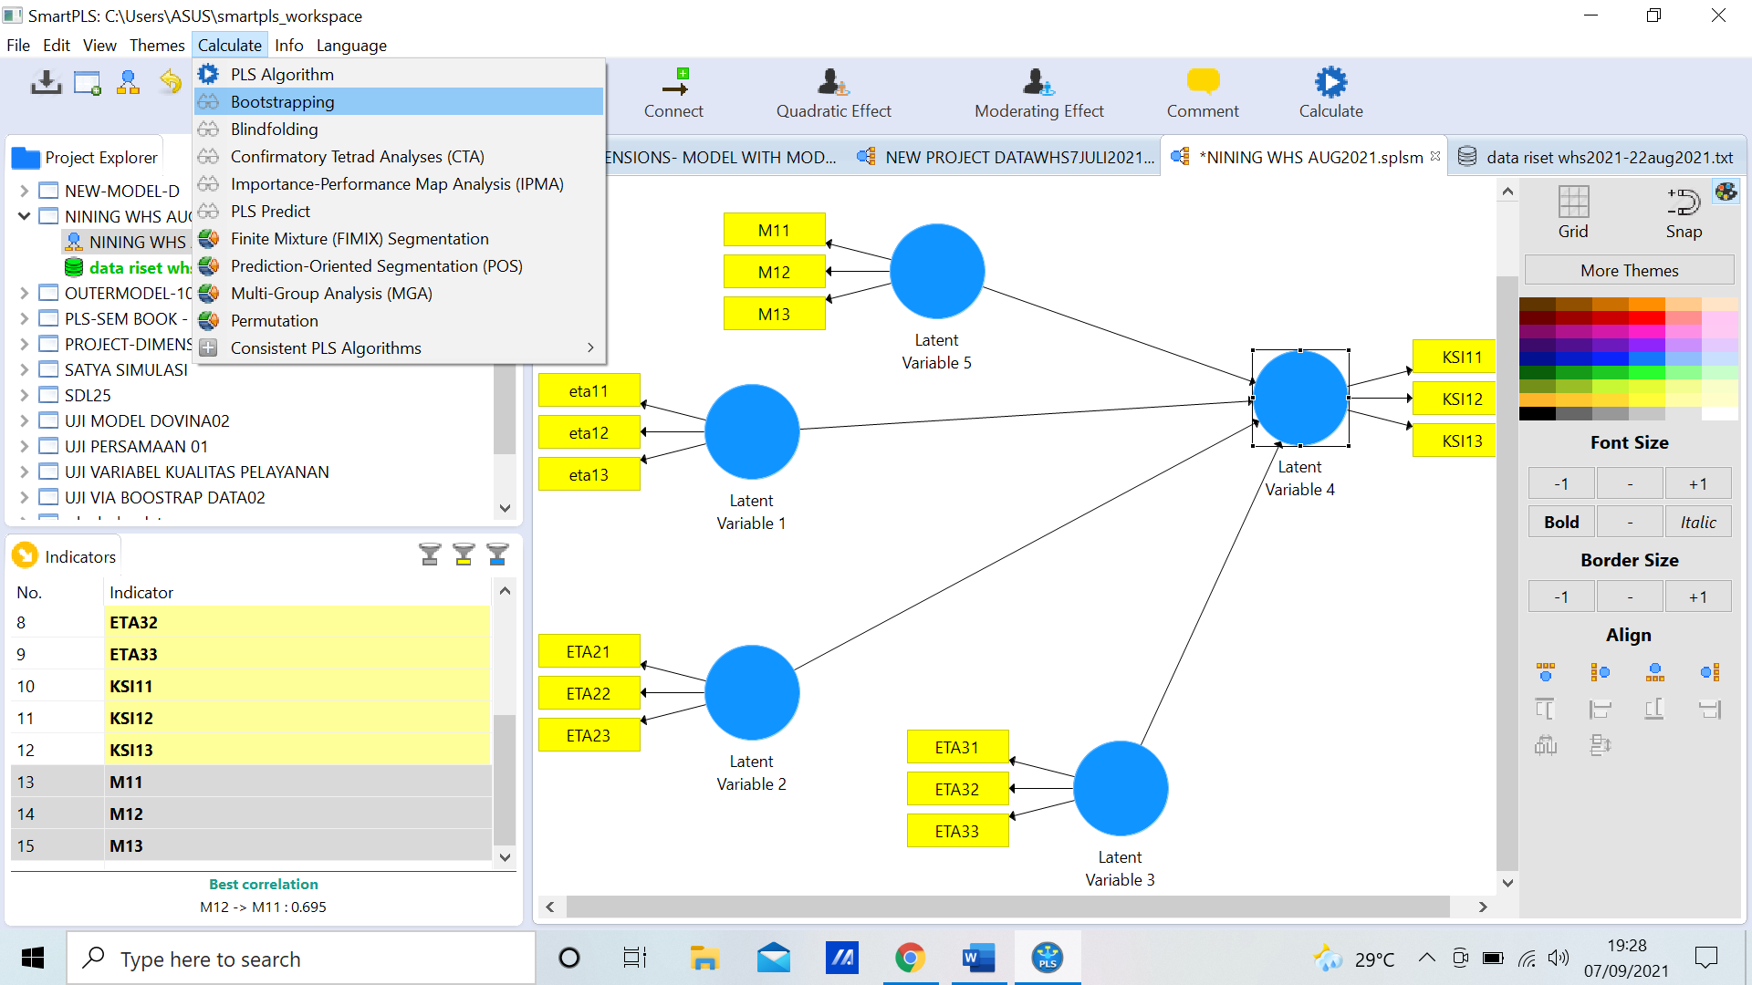
The resampling methods (Only for the Inner Model).
The resampling standard methods has bootstrapping data processing (sign change, individual sign change and construct level change) within SEM-PLS that it a means of accuracy from the estimating the real samples

Slide 56
Inner model conduct to the bootstrapping within subsamples to basic setting to 10.000

Slide 57
The prediction the relationship- among variable
Indeed, the structural model (inner-model to assessment for the significance of the prediction the relationship- among variable would indicate conduct to the p-value less than .05 for the level of the significantly accepted among hypotheses of 95%,

Slide 58
The Data for the outer loadings within p-value the coefficient for accepted entire hypotheses in management dan business research model

Slide 59
Path coefficients

Slide 60
INDIRECT EFFECTS

Slide 61
The scheme of Inner-model result research with p-value coefficients

Slide 62
The Data for estimate the level of contribution within the prediction- model within the R Square coefficient

Slide 63
The Data for f Square

Slide 64
PLS-SEM CRITERIA

Slide 65
The Model Evaluating for the Reflective Measurement model- the outer loading- Reflective
The model evaluating have two stage conduct to the SmartPLS analysis for the management and busines research model that it was divide to the outer model evaluation and the inner model evaluation. The reflective measurement/ outer model should to assessment conduct to the rule of thumb coefficient pertains (Ghozali, 2021):
1). The convergence validity (the loading factor coefficient, an average variance extracted (AVE) and communality), 2). The discriminant validity (the cross loading, the root- square of AVE and the correlation between among latent construct, the Heterotrait- monotrait ratio (HTMT)) and, 3). The reliability assessment (The Cronbach’s Alpha and the Composite Reliability).

Slide 66
OUTER MODEL

Slide 67
The inner model to evaluate
Furthermore, the scholar should do assessment for the inner model to evaluate of the yielding data from the data processing within the SmartPLS in the structural management and business research model pertains:
1). The level of robust of the research model (R-square value), 2). The effect size (f- square), 3). The Level of predictive – relevance (Q-square) and, 4). The significance- two-tailed of hypotheses assessments (t-value)

Slide 68
INNER MODEL

Slide 69
FIT MODEL

Slide 70
DISCUSSION
TO THE FORUM

